Slide 1
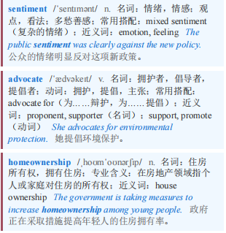
BUTTONWOOD Buttonwood专栏 本课程来自公众号：熊猫外刊精读
【1】“That our people should live in their own homes is a sentiment deep in the heart of our race and of American life,” said President Herbert Hoover, perhaps the most important advocate of mass homeownership in the country’s history, in 1931. “They never sing songs about a pile of rent receipts.”
1931年，赫伯特·胡佛总统说：“我们的人民应该住在自己的家里，这是我们民族和美国生活的核心情感。他们从不唱关于一堆房租收据的歌。”胡佛总统或许是美国历史上对大规模拥有住房最为重要的倡导者。

Slide 2
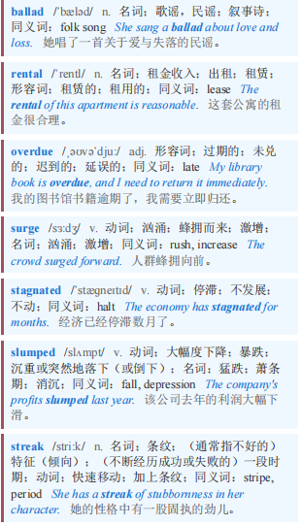
BUTTONWOOD Buttonwood专栏
【2】But a ballad about the rental market is overdue. When rich-world interest rates began to surge in 2022, renting became a better deal than buying. House prices have since stagnated or slumped in many places, and rates are falling. Even so, there is reason to think that the winning streak for renters will continue.
但一首关于租赁市场的歌谣早就该出现了。当富裕国家的利率在2022年开始飙升时，租房变得比买房更划算。此后，许多地方的房价停滞不前或大幅下跌，利率也在下降。即便如此，仍有理由认为租房者的连胜势头将继续下去。

Slide 3
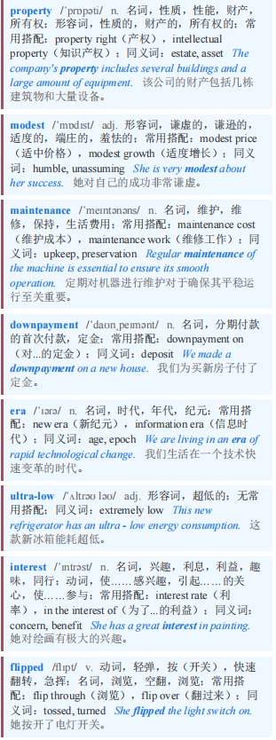
BUTTONWOOD Buttonwood专栏
【3】According to Zillow, an American property website, the monthly cost of buying and keeping a home—including taxes, insurance, a modest maintenance cost and a downpayment of 20%—came to less than that of renting from 2015 to 2021, an era of ultra-low interest rates. Since then, however, the picture has flipped. Today a new buyer pays about $400 more a month. In several of the country’s largest cities, the difference runs to thousands of dollars a month.
根据美国房产网站Zillow的数据，在2015年至2021年超低利率时代，购买并持有一套房子的月成本（包括税费、保险费、适度的维护成本以及20%的首付）低于租房成本。然而，自那以后情况发生了逆转。如今，新购房者每月要多支付约400美元。在美国几个最大的城市，每月的差价达到数千美元。

Slide 4
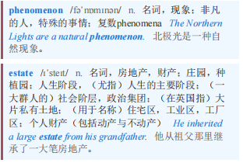
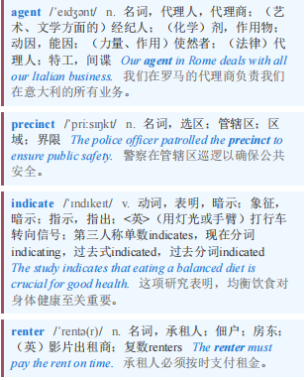
BUTTONWOOD Buttonwood专栏
【4】This is not just an American phenomenon. According to CBRE, an estate agent, there is no Australian precinct where it is cheaper to buy a flat than to rent one. Rathbones, a British wealth-management firm, estimates that rental yields—the amount landlords make from tenants relative to the price of the house—are 5% or so, not much above the 4.4% for five-year fixed mortgages. Given that landlords must also meet steep maintenance and tax costs, this indicates renters are getting a good deal.
这不仅仅是美国的现象。据房地产经纪公司世邦魏理仕（CBRE）称，在澳大利亚，没有哪个区域买公寓比租公寓便宜。英国财富管理公司Rathbones估计，租金收益率（房东从租户那里获得的收入相对于房价的比例）约为5%，仅略高于五年期固定抵押贷款的4.4%。鉴于房东还必须承担高昂的维护和税费成本，这表明租房者得到了划算的交易。

Slide 5
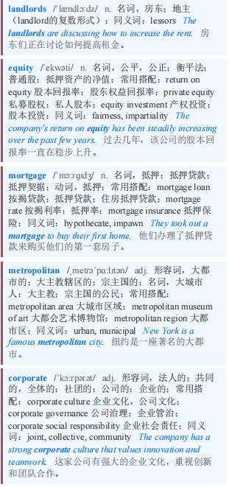
BUTTONWOOD Buttonwood专栏 本课程来自公众号：熊猫外刊精读
【5】Renters often fear they are throwing away money by handing it to landlords, while buyers build up home equity. But property is not the only investment available. Arthur Cox of the University of Northern Iowa finds that, even from 1984 to 2013, a period in which house prices rose overall and mortgage rates fell sharply, people were sometimes better off if they avoided homeownership. In three of the six American metropolitan areas he investigated, renting and investing the extra money that would have been required for mortgage payments in stocks and corporate bonds was the more profitable choice over the period.
租房者常常担心把钱交给房东是在浪费钱，而购房者则在积累房屋净值。但房产并非唯一可投资的项目。北爱荷华大学的亚瑟·考克斯发现，即使在1984年至2013年期间（房价总体上涨且抵押贷款利率大幅下降），人们有时不买房反而更好。在他调查的六个美国大都市区中，有三个地区在这段时间内，租房并将原本用于支付抵押贷款的额外资金投资于股票和公司债券是更有利可图的选择。

Slide 6
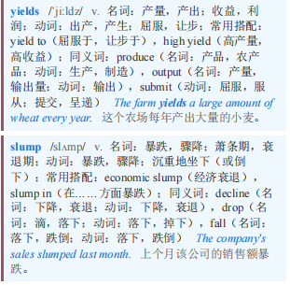
BUTTONWOOD Buttonwood专栏
【6】True, in some places renters have lost ground. In Hong Kong rental yields have risen from less than 2.5% four years ago to 3.5% today. The shift has been driven by a slump in house prices, which have fallen by a third in real terms since 2021.
诚然，在一些地方，租房者的处境变得更糟了。在香港，租金收益率从四年前的不到2.5%上升到如今的3.5%。这一转变是由房价暴跌推动的，自2021年以来，房价实际下跌了三分之一。

Slide 7
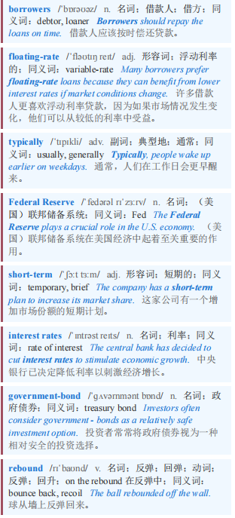
BUTTONWOOD Buttonwood专栏
【7】But there is a difference between mortgages in Hong Kong and those in other rich-world locations. Hong Kong’s borrowers mostly take on floating-rate mortgages, which typically move with the Federal Reserve’s short-term interest rates. Elsewhere, mortgages are more likely to depend on longer-term rates. And they have barely budged: despite recent interest-rate cuts, five- and ten-year government-bond yields mostly sit where they did three years ago. In America 30-year mortgage rates remain above 6%, more than twice the rock-bottom levels reached in the covid-19 pandemic. Although buyers can find shorter-term mortgages, they take on the risk of a rebound in inflation and thus rates.
但香港的抵押贷款与其他富裕地区的抵押贷款存在差异。香港的借款人大多承担浮动利率抵押贷款，这类贷款通常会随美联储的短期利率变动。在其他地方，抵押贷款更有可能取决于长期利率。而且长期利率几乎没有变动：尽管近期有降息，但五年期和十年期政府债券收益率大多维持在三年前的水平。在美国，30年期抵押贷款利率仍高于6%，是新冠疫情期间触及的最低水平的两倍多。尽管购房者可以找到短期抵押贷款，但他们要承担通胀反弹以及随之而来的利率反弹的风险。

Slide 8
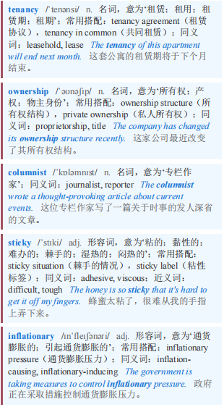
BUTTONWOOD Buttonwood专栏
【8】Picking a likely victor in the battle between tenancy and ownership therefore means taking a view on the future of long-term interest rates. Your columnist would suggest that they look worryingly sticky. Concerns about government debt and long-term inflationary pressures are not going anywhere.
因此，在租赁与所有权的较量中挑选一个可能的赢家，意味着要对长期利率的未来走势有一个看法。本专栏作者会认为，长期利率看起来高得令人担忧且难以回落。对政府债务和长期通胀压力的担忧不会消失。

Slide 9
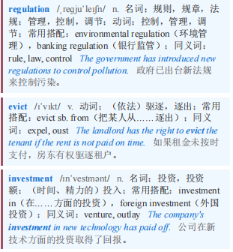
BUTTONWOOD Buttonwood专栏
【9】Moreover, in recent years renter-friendly regulation has swept the West. Britain’s Renters’ Rights Act makes it more difficult for landlords to evict residents, and enables tenants to challenge rent increases via tribunals. Many American cities have frozen regulated rents, as Zohran Mamdani, New York’s new mayor, intends to do in his city. Such rules are terrible news for anyone considering making an investment in housing, and they tip the calculation further in favour of tenants.
此外，近年来，有利于租房者的法规席卷了西方。英国的《租房者权利法案》加大了房东驱逐住户的难度，并使租户能够通过法庭对租金上涨提出质疑。许多美国城市已经冻结了受管制的租金，纽约新任市长佐兰·曼达尼也打算在他的城市这么做。对于任何考虑投资住房的人来说，这样的规定都是个坏消息，它们进一步使天平向租户倾斜。

Slide 10

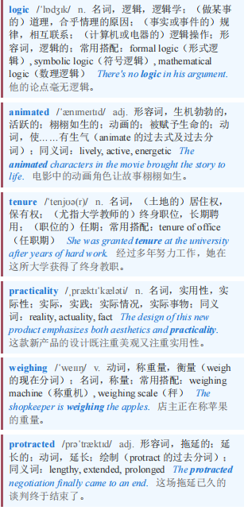
BUTTONWOOD Buttonwood专栏 本课程来自公众号：熊猫外刊精读
【10】Buyers have reasons to own a home that surmount cold financial logic. Many feel the same emotional pull that animated Hoover almost a century ago. Others want a secure and long tenure. And in some markets, it is just a question of practicality: finding a large, single-family home to rent can be difficult. But for the cool, unemotional resident weighing up the pros and cons of buying, there is a clear winner. Without a much steeper fall in house prices, a sudden decline in long-term interest rates or a protracted surge in rents, renting will remain the better option.
购房者有理由拥有一套超越冰冷金融逻辑的住房。许多人感受到了近一个世纪前胡佛所激发的那种情感拉力。其他人则希望有一个安全且长期的居住权。在一些市场，这仅仅是一个实用性的问题：找到一个大的独栋家庭住宅来租可能很困难。但对于冷静、理性的居民在权衡购房的利弊时，有一个明确的赢家。如果房价没有大幅下跌、长期利率没有突然下降或租金没有长期飙升，租房仍将是更好的选择。

